Slide 1
TITLE:SMART PARKING AND AUTOMATED VACANCY PREDICTOR.
BATCH-2
SUBMITTED TO:
DR.CH.AMARESH
SUBMITTED BY:(SEC-2)
MUKESH.M-241FA04522 ARMAN SHAIK-241FA04834
ROHITH.P-241FA04E89
DINESH.S-241FA04F13

Slide 2
INTRODUCTION:
Smart parking is an advanced solution designed to reduce traffic congestion and save time by helping drivers quickly find available parking spaces. In busy cities, a large amount of time is wasted searching for parking, which increases fuel consumption and pollution. This system uses modern technologies like IoT, sensors, and machine learning to monitor parking spaces and predict future availability, making parking more efficient and user-friendly.

Slide 3
The Smart Parking and Automated Vacancy Predictor system provides a digital platform where users can view available parking spaces in real time and also get predictions about future availability. The system collects data from sensors or cameras installed in parking areas and processes it using a backend server. Machine learning algorithms analyze historical data to predict when parking slots will become available.
Key Points:
Real-time slot monitoring
Data collection using sensors or cameras
Prediction using machine learning
User-friendly web or mobile interface

Slide 4
TECHNOLOGIES USED:
This project uses a combination of hardware and software technologies. Frontend technologies like HTML, CSS, and JavaScript are used to design the user interface. Backend technologies such as Node.js or Python handle server-side operations. Databases like MySQL or MongoDB store parking data. Machine learning libraries like Scikit-learn or TensorFlow are used for prediction.
Key Points:
Frontend: HTML, CSS, JavaScript
Backend: Node.js / Python
Database: MySQL / MongoDB
ML Tools: Scikit-learn, TensorFlow
IoT: Sensors, Arduino (optional)

Slide 5
SOURCE CODE:
<!DOCTYPE html>
<html lang="en">
<head>
<meta charset="UTF-8">
<meta name="viewport" content="width=device-width, initial-scale=1.0">
<title>Smart Parking System</title>
<style>
body {
margin: 0;
font-family: Arial;
background: #f4f7fb;
}
header {
background: #1e293b;
color: white;
padding: 15px;
text-align: center;
}

Slide 6
nav {
background: #334155;
display: flex;
justify-content: center;
gap: 10px;
padding: 10px;
}
nav button {
background: #2563eb;
color: white;
padding: 10px 15px;
border: none;
cursor: pointer;
border-radius: 5px;
}
.container {
padding: 20px;
}
.page {
display: none;
}
.page.active {
display: block;
}

Slide 7
.cards {
display: flex;
gap: 20px;
flex-wrap: wrap;
}
.card {
background: white;
padding: 20px;
border-radius: 10px;
flex: 1 1 250px;
text-align: center;
box-shadow: 0 4px 10px rgba(0,0,0,0.1);
}

Slide 8
.grid {
display: grid;
grid-template-columns: repeat(auto-fill, minmax(80px, 1fr));
gap: 10px;
margin-top: 20px;
}
.slot {
padding: 15px;
border-radius: 8px;
text-align: center;
cursor: pointer;
}
.available {
background: #22c55e;
color: white;
}
.occupied {
background: #ef4444;
color: white;
} function update() {
renderGrid();
}
renderGrid();
</script>
</body>
</html>

Slide 9
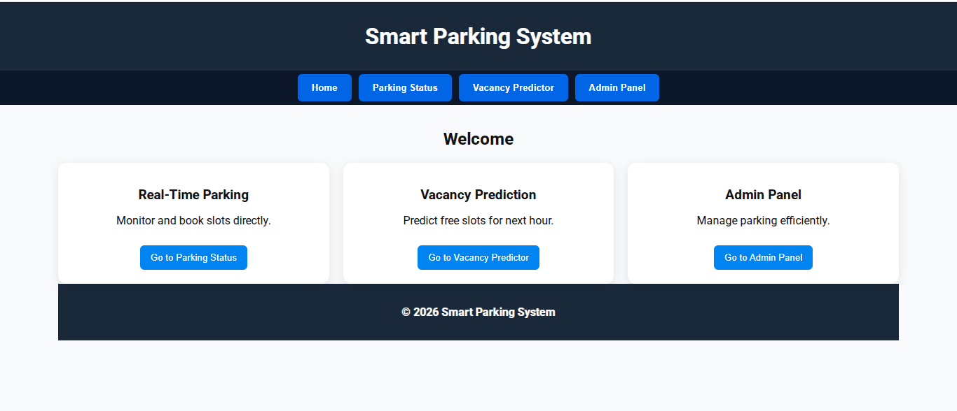
OUTPUT:

Slide 10
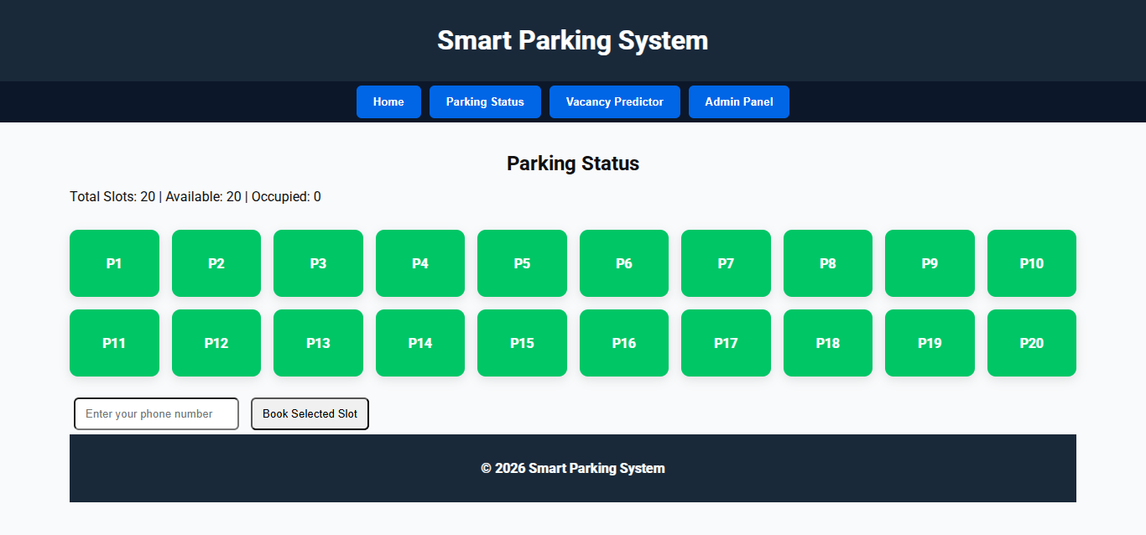

Slide 11
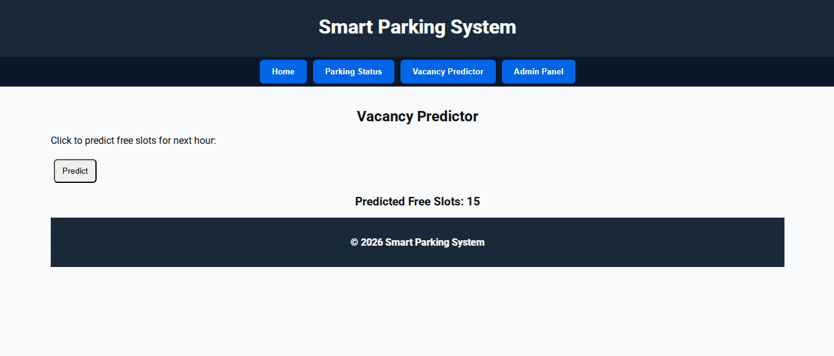

Slide 12
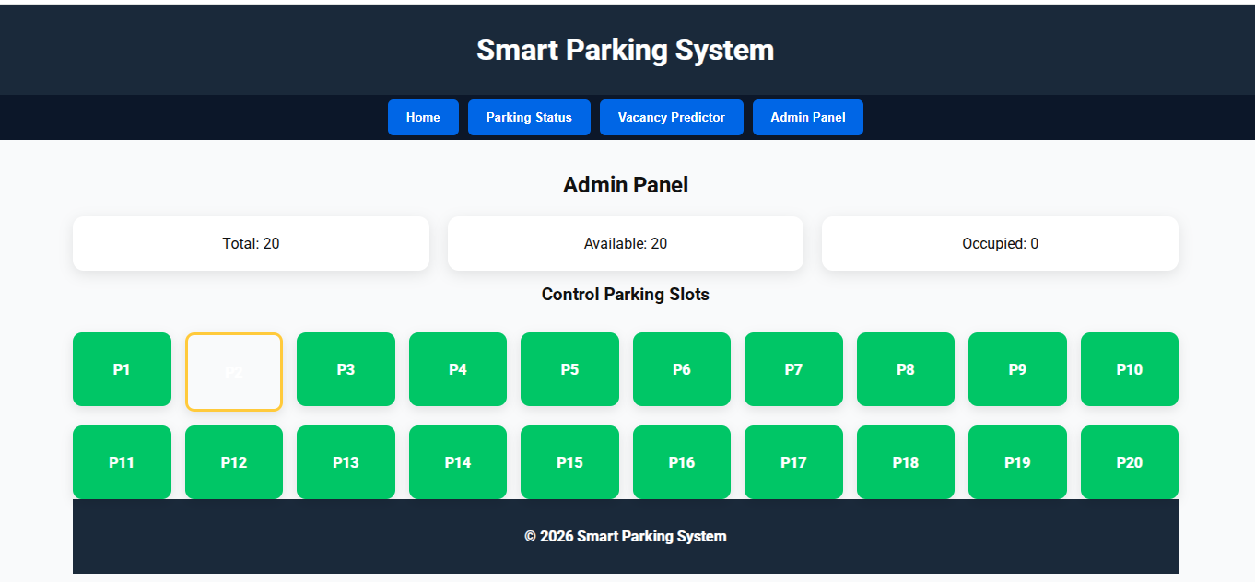

Slide 13


